Slide 1
Achieve
Your
THE INSTITUTE OF COST ACCOUNTANTS OF INDIA
(Statutory body under an Act of Parliament)
Headquarters: CMA Bhawan, 12, Sudder Street, Kolkata - 700 016
Phone: +91-33-2252-1031/34/35/1602/1492/1619/7373/7143
Delhi office: CMA Bhawan, 3, Institutional Area, Lodhi Road, New Delhi - 110 003
Phone: +91-11-2462-2156/2157/2158

Slide 2
Guidance to the Student as a way to approach to the Examination:
Pre- Examination Guidance:
Way to revise: Students are advised to revise the entire syllabus and to complete it before going to the bed. Understand rather than mugging up the concept.
b) Stress: During revision don’t be panic just make your plan to revise the entire syllabus and follow them diligently.
c) Health is Wealth: Students are advised to be healthy so need to have proper diet during the examination.

Slide 3
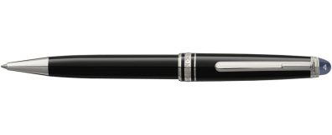
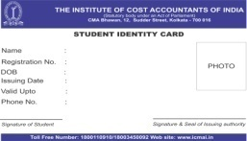
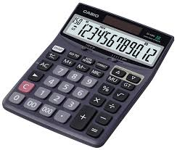
d) Timings of Examination: Examination will be conducted during the allotted times shown in the examination time table. The examination hall will be open for admission before 30 minutes of the time scheduled for the commencement of the examination. Students are advised to find your allocated seat and proceed toward the examination room.
e) What to carry with yourself for the examination:
Admit Card,
Pen,
Pencil,
Laminated Photo Identity Card (issued by DOS)
Calculator (not the scientific one)

Slide 4
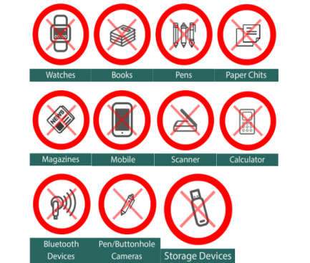
f) Personal Belongings: All your belonging such as bags, mobile, books, laptops etc must be placed at the designated area outside the examination hall at your own responsibility . The Institute will not be responsible for the loss of any belongings in or outside the examination hall.
g) Items not permitted in the examination Hall: Any books, pictures, documents, mobile, pager or any electronic material like PC, Laptop, Smart watch, gaming device etc. No food or drink other than water to be brought in the examination hall.

Slide 5
h) Certain Do’s:
Proper utilisation of 15 minutes reading time. You have 3hrs i.e 180 minutes and the examination is for 100 marks so for each marks the time allotted is 1.8 minutes. Any 8 marks question to be solved in 8 x 1.8 min= 14.4 minutes. Remember if you are going beyond this time schedule then you need to gear up and adjust somewhere.
Answer to the questions chronologically i.e., if a question have three sub parts a, b & c it should be answered systematically. i.e. first a then b then c.
Proper showcase of your answer so have proper writing practice. Write answers clearly.
Arrive at the test center before schedule time.
Keep the following item on the desk your admit card, identity card, pen and pencil.
Tell the invigilator/Supervisor if you think you have been given wrong question paper and any unwanted material is lying there in your allotted seat.
Exercise.
Find a quite space to revise.
Self discipline.

Slide 6
Certain Don’ts:
Avoid using any mal practice. The Institute will take serious action against cheating.
Students are advised to wear casual garments except Sleeveless shirts and half paints.
Talk or disturb other candidates.
Eat or smoke in the test room.
Lend anything to or borrow anything from them.
Leave the room without permission of Invigilator.
Co-operate with the instruction of Invigilator.
Copying the work of other candidate.
Don’t communicate with anyone in the examination hall.
Consultation with others during exam is strictly prohibited.
Do not be panic stricken and immediately start counting the probable marks in the paper already got over. Do it once your all papers are over.

Slide 7
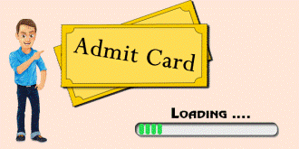
j) After the Examination:
Submit the answer paper to the exam supervisor.
Collect admit card.
Check whether admit card bears the signature of Invigilator.
Take your personal belongings.
On the last date of examination please check whether the chief Invigilator sign the admit card.

Slide 8
2. Post - Examination Guidance:
Reach home and take proper rest.
Again repeat the whole exercise till your last examination.

Slide 9
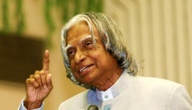
We wish you all success in your life. May you will reap all the benefits in form of such preparation.
“TO SUCCEED IN YOUR MISSION, YOU MUST HAVE SINGLE MINDED DEVOTION TO YOUR GOAL”
- APJ Abdul Kalam, Former President of India
Directorate of Studies

Slide 10
G
N
T
H
A
N
K
I
Y
O
U
THE INSTITUTE OF COST ACCOUNTANTS OF INDIA
(Statutory body under an Act of Parliament)
Headquarters: CMA Bhawan, 12, Sudder Street, Kolkata - 700 016
Phone: +91-33-2252-1031/34/35/1602/1492/1619/7373/7143
Delhi office: CMA Bhawan, 3, Institutional Area, Lodhi Road, New Delhi - 110 003
Phone: +91-11-2462-2156/2157/2158

